Slide 1
Region Wise Analysis To Achieve Digital India
Digital platform can change in education sector
Power of technology
Electricity facility and computer facility in all government schools in India

Slide 2
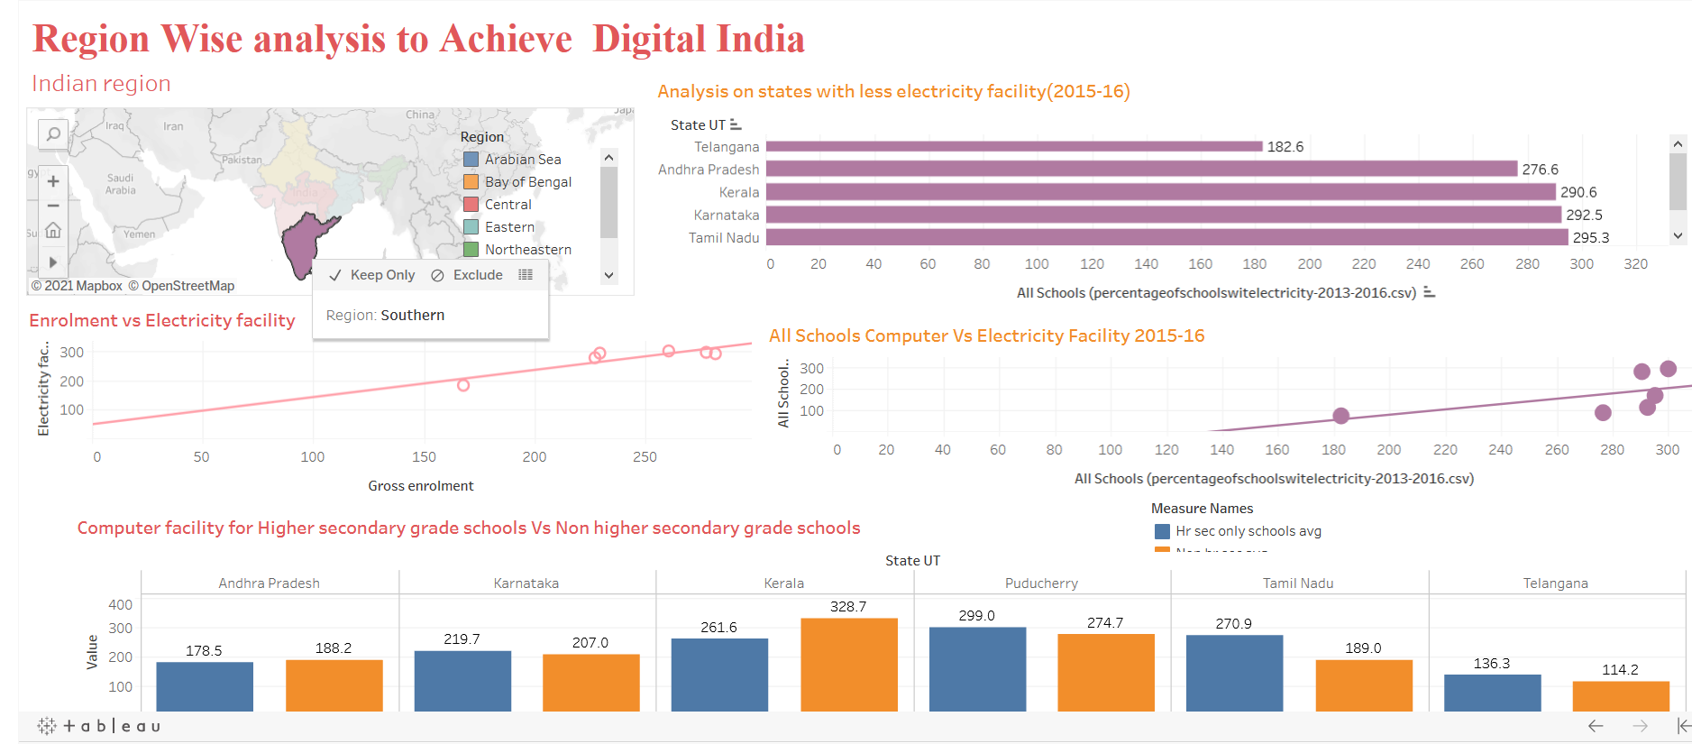

Slide 3
Gross Enrollment Analysis State wise
Grade wise Enrolment
State wise Enrolment
Enrolment vs toilet facility
Can toilet facility promote education?

Slide 4
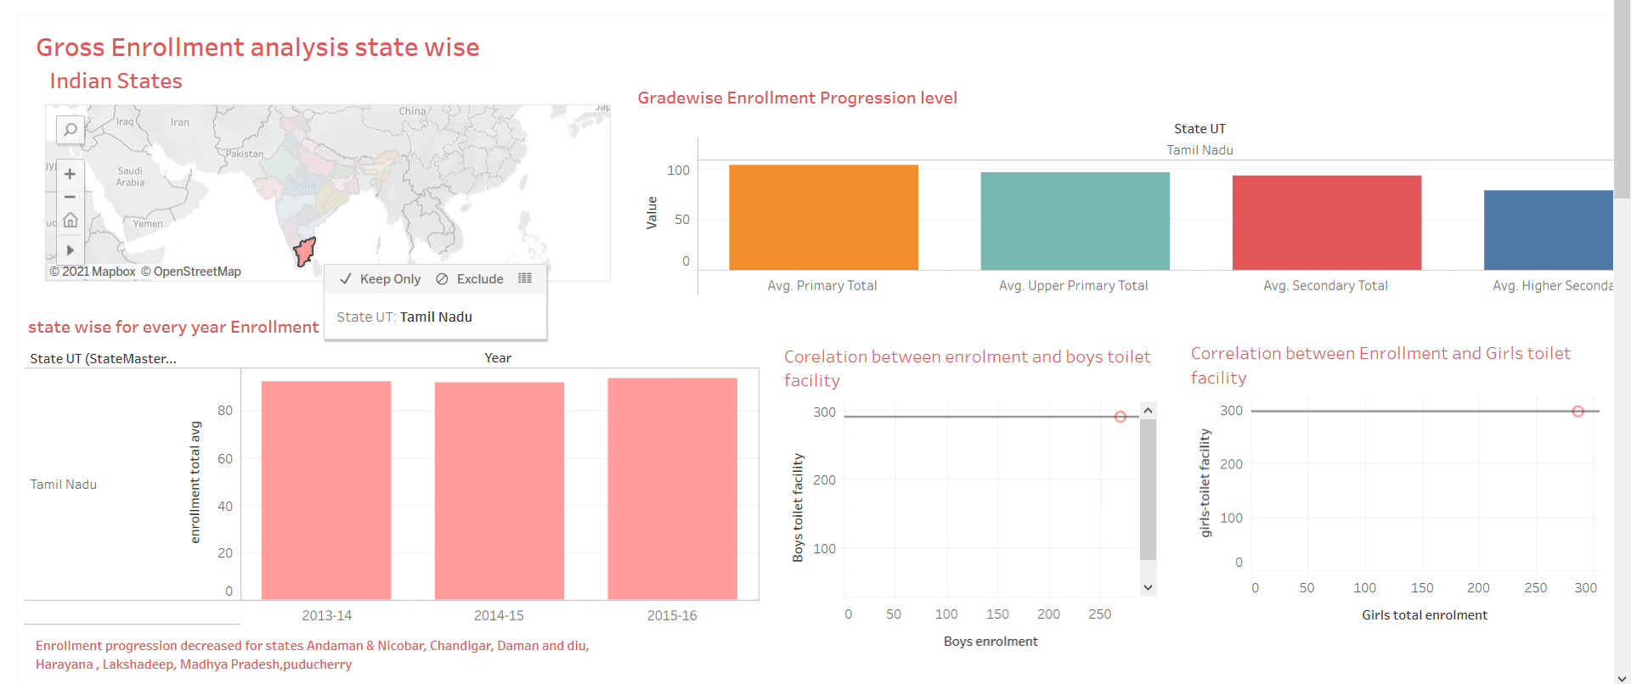

Slide 5
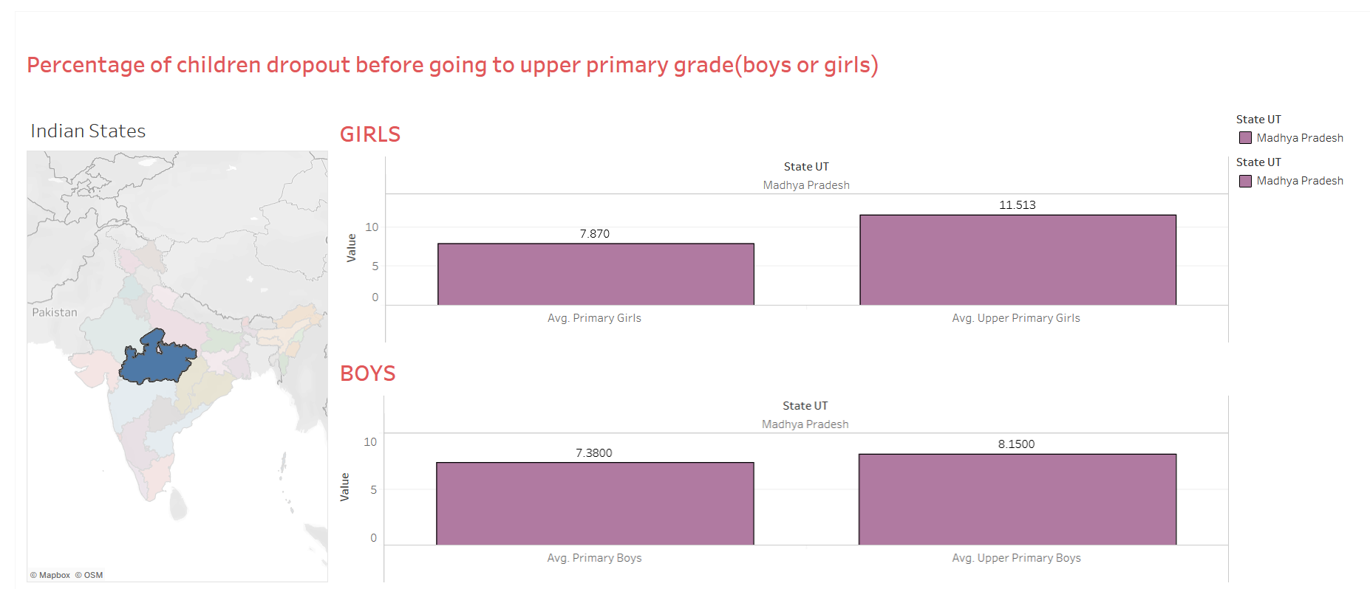
Percentage of children dropout before going to upper primary grade(boys or girls)

Slide 6
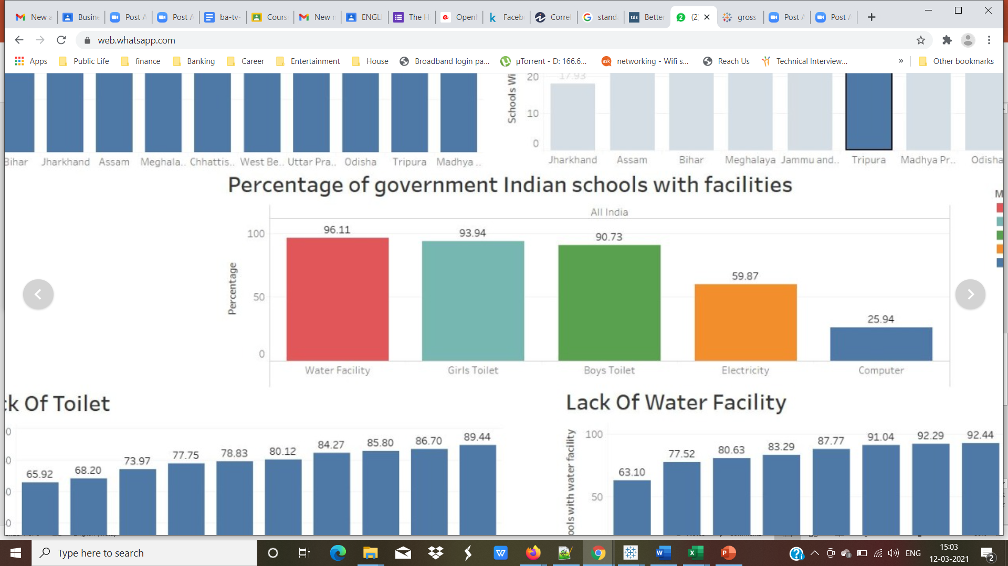
Conclusion overall Percentage of basic facilities in Indian government schools

Slide 7
Conclusion
Digitalization
Enrolment vs facilities
Dropout vs facilities

Slide 8

JAI HIND!!!
THANK YOU!!!

